Slide 1
Improving Quality, Informing Families
Early Childhood Education Cabinet
10/31/13
Race to the Top
Early Learning Challenge

Slide 2
High Quality Care for Children with High Needs
High Needs Categories | Number of Children*
Low-Income Children | 80,000
With Disabilities or Developmental Delays | 9,000
English Language Learners | 13,600
Homeless/In Shelters | 5,000
In Foster Care | 2,000
With Special Healthcare Needs | 23,300
With DCF Open Cases | 19,000
*From birth to Kindergarten entry
CONNECTICUT OFFICE OF EARLY CHILDHOOD
Notes:
~40,000 children born annually in CT,
number of children below kindergarten entry,
Many of whom get subsidized care from the state

Slide 3
High Quality Care for Children with High Needs
State Funded Programs
High Quality Substantial Support for Quality Substantial State Oversight Serve 22,000 Children with High Needs
Other Subsidized Programs
Of Unknown Quality Minimal Support for Quality No State Oversight Serve 25,000 Children with High Needs
CONNECTICUT OFFICE OF EARLY CHILDHOOD
Notes:
State Funded Programs= Headstart, School Readiness, etc.
Partially Subsidized Programs= XXX

Slide 4
ConneCT to Quality System
Help Families with Children with High Needs Access and Afford High Quality
Provide Supports and Incentives to Improve Quality
Create System to Rate Quality
CONNECTICUT OFFICE OF EARLY CHILDHOOD
Notes:
Create a system of oversight for publically funded programs, public rankings, and support for quality improvement

Slide 5
Promoting Access
Supports for Families to Find and Use High-Quality Care
Plain Language Website
Community Outreach
Financial Supports and Incentives
CONNECTICUT OFFICE OF EARLY CHILDHOOD

Slide 6
Improving Quality
Supports
Regional Quality Improvement Centers Licensing and accreditation specialists Health and Behavioral Health Consultants Trainers and Coaches Family Childcare Specialists Career counselors
Improved Licensing Process
Workforce, Program, and Early Learning Standards
CONNECTICUT OFFICE OF EARLY CHILDHOOD
Notes:
Help programs become licensed and move up in levels of quality while continuing to serve children with high needs

Slide 7
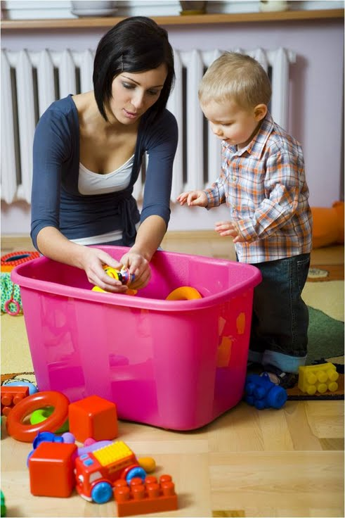
Improving Quality
Incentives
Annual Quality Achievement Awards
Quality Improvement Grants
Capital Improvement Grants
Tiered Care 4 Kids Reimbursements
Scholarships for the Workforce
Start Bonuses
CONNECTICUT OFFICE OF EARLY CHILDHOOD
Notes:
Help programs become licensed and move up in levels of quality while continuing to serve children with high needs

Slide 8
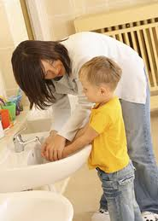
Rating Quality
Standard | Description
Core Knowledge and Competencies | What early childhood workforce should be able to do and know
Early Learning and Development Standards | What children should be able to do and know across domains
Program Standards | What programs should be doing to create and excellent learning environment
CONNECTICUT OFFICE OF EARLY CHILDHOOD
Notes:
Help programs become licensed and move up in levels of quality while continuing to serve children with high needs

Slide 9
Rating Quality
Quality Rating Scale | Broad Overview of Requirements | Status
Level 5 | Accreditation plus workforce requirements | Under Consideration
Level 4 | Accreditation by NAEYC, NAFCC, Head Start | Ready for Launch (A process for approval of other accreditation systems is under development.)
Level 3 | External Assessment (i.e. CLASS and ERS) | In Development
Level 2 | Self- Assessment and Plans for Improvement | In Development
Level 1 | Licensed | Ready for Launch
Not rated | Unlicensed
CONNECTICUT OFFICE OF EARLY CHILDHOOD

Slide 10
Rating Quality
CONNECTICUT OFFICE OF EARLY CHILDHOOD
Notes:
Help programs become licensed and move up in levels of quality while continuing to serve children with high needs

Slide 11
Major Grant Strategies
Strengthen State Governance System $4.3 m
Launch the Quality Rating and Improvement System $1 m
Provide Supports to Improve Quality $12 m
Provide Incentives to Improve Quality $12 m new, $27 m existing
Inform Families of Program Quality $1.7 m
Help Family Afford High Quality Care $2 m
Continue to Enhance Workforce, Program, and Learning Standards $100k
CONNECTICUT OFFICE OF EARLY CHILDHOOD
Notes:
Major Strategies in the Race to the Top Application

Slide 12
Major Grant Strategies
Improve the Licensing System $50k grant, $6.5 m state
Screen Additional Children $800k
Increase the Coordination of Workforce Education $2.2 m
Develop a new Kindergarten Entry Assessment $1.5 m
Sustain Early Learning through Third Grade $800k
Build and Early Childhood Information System $6m existing
CONNECTICUT OFFICE OF EARLY CHILDHOOD
Notes:
Major Strategies in the Race to the Top Application

Slide 13
Questions?
CONNECTICUT OFFICE OF EARLY CHILDHOOD

