Slide 1
An Early Childhood System for Connecticut’s Children
The Implementation of
Public Act 11-181
Myra Jones-Taylor, Ph.D. September 27, 2012
Early Childhood Planning Director

Slide 2
Planning Updates
System planning update
Quality Enhancement update
QRIS update

Slide 3
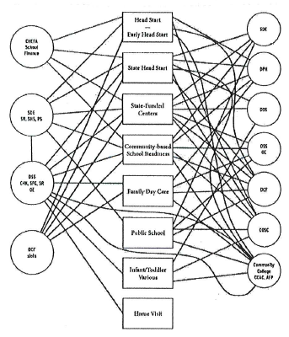
Where We Started
Notes:
The current picture of Connecticut’s early childhood system is complex and confusing. The programs are in the boxes down the center, the funding streams on the left and state agencies on the right. One potential inefficiency that is inherent in this complexity is the administrative costs of money flowing through multiple entities before reaching the program that touches the child. With better alignment, Connecticut could more effectively serve children and improve outcomes.

Slide 4
EC Activities in CT State Agencies
Governor
OPM
SDE
DPH
DCF
DDS
Birth to 3 (Home visiting)
Licensing
Bureau of Special Education
Head Start/DCF Collaboration
Home Visiting Grant
Nurturing Families (Home visiting)
Help Me Grow
Child Care Team
Care 4 Kids (with United Way)
Children’s Trust Fund
Board of Regents
CT-Charts-a-Course
Accreditation Facilitation Project
Scholarships
Training/career counseling
Workforce development
Registry
Early Childhood Planning Office
Early Childhood Special Education
Bureau of Teaching and Learning
Head Start Collaboration Office
Early Childhood Cabinet
School Readiness
State Head Start Grant
Child Development Centers
Family Resource Centers
Bureau of Health, Nutrition, Family Services and Adult Education
Bureau of Data Collection, Research, And Evaluation
Family Services Division
DSS
Data on preschool age children (PKIS / PSIS)
CAPTA - link to Birth-to-3
Infant Toddler child welfare checklist
Funding for Child First and ECCP

Slide 5
Rationale for a Coordinated System: What problems will it solve? What functions will it serve?
Current Challenges
Inefficient
Multiple programs create redundancy and multiple administrative structures
Not Family-Friendly
Challenging for families to make informed choices and access programs they need
Uneven quality
Different standards and requirements create uneven quality of services
Difficulties connecting to related services
Challenging for programs to access the comprehensive services children and families need and for these services to connect with the various programs

Slide 6
Proposed Guiding Values and Principles From the EC Systems Working Group
Optimally, a comprehensive early childhood system will:
Reach all children and families, and as early as possible, with needed services and supports
Ease access for families and transitions for children
Value parents as decision makers and leaders
Ensure stability and continuity of services along a continuum from prenatal into school entry and beyond
Genuinely include and effectively accommodate children with special needs
Reflect and respect the strengths, needs, values, languages, cultures and communities of children and families
Catalyze and maximize investment and foster innovation

Slide 7
Quality Enhancement: Building CT’s QRIS
Early Learning & Development Standards
Comprehensive Assessment System
Program Monitoring System
Health Promotion Practices
EC Educator Qualifications
Family Engagement Strategies

Slide 8
QRIS Timeframe
November
QRIS work group recommendations
Cabinet leadership team review of recommendations
Cabinet votes on whether to approve the recommendations
December - January
Receive public input
Planning Office makes recommendations to Governor Malloy

